Slide 1

Threat
Intelligence Report

Slide 2

Overall summary and overview
1.3m
Total number of files uploaded to Rebuild Engine and processed
100%
Percentage of files that needed to be sanitized
30%
Percentage of files that were allowed to enter organisation
docx, pdf, png
The most common file types
10sec
Average file process time

Slide 3
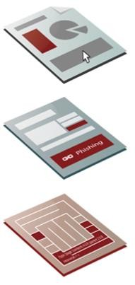
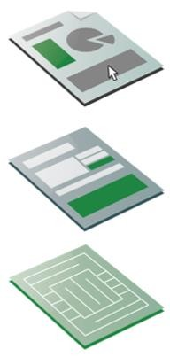
How it works
Visual Content layer This is the layer presented to the
viewer, the only layer you see
Text, graphics and formatting are lifted up Words, context and visual appearance are in stasis during regeneration process
Sanitisation Policy Applied Removal of DDE, Macros, JavaScript, Embedded Files, URL links & Acroforms
File Structure Remediation Fie is regenerated back to the original. threat-free file specification, as designed by the manufacturer
Visual Content layer
The user receives an identical document with complete integrity and no loss of resolution
Functional layer
RISKS:
DOE Ransomware, Malicious Macro & JavaScript, Corrupted Acroform and Phishing URLs
Functional layer
Controlled by policy, the customer has total flexibility to remove unnecessary functional features in files
File Structure layer
RISKS:
Sophisticated APTs, Advance ‘File-less’ Malware, Hidden Malicious Scripts
File Structure layer
File is threat-free and now conforms to a safe and trusted standard
DEEP-FILE INSPECTION
REMEDIATION & SANITISATION
TECHNOLOGY

Slide 4
Emails and files processed
FILE STATUS | TOTAL NUMBER OF FILES
ALLOWED The original file is provided to the recipient | XYX
DISALLOWED No file is provided to the recipient | XYX
CLEAN The file was rebuilt but required no remediation or sanitization | XYX
REMIDIATED The file required structural fixes for conformance in regeneration | XYX
SANITIZED The file required removal of active content | XYX
HELD The file was not sent to the recipient due to being Malware | XYX

Slide 5
Outcomes by file type
FILE STATUS | TOTAL NUMBER OF FILES
ALLOWED The original file is provided to the recipient | XYX
DISALLOWED No file is provided to the recipient | XYX
CLEAN The file was rebuilt but required no remediation or sanitization | XYX
REMIDIATED The file required structural fixes for conformance in regeneration | XYX
SANITIZED The file required removal of active content | XYX
HELD The file was not sent to the recipient due to being Malware | XYX

Slide 6
Modern and legacy Microsoft Office file types
Category | File Type | Extension | Number of Files Processed
Microsoft Office Legacy | Microsoft Word Microsoft Excel Microsoft PowerPoint | doc, dot xls, xlt, xlm ppt, pot, pps | XYZ
Microsoft Office 2007+ | Microsoft Word Microsoft Excel Microsoft PowerPoint | docx, dotx, docm, dotm xlsx, xltx, xlsm, xltm pptx, potx, ppsx,pptm, potm, ppsm | XYZ

Slide 7
Unsupported file types count
Unsupported File Type | Total Count of Unsupported Files
Unsupported File Type #1 | XYX
Unsupported File Type #2 | XYX
Unsupported File Type #3 | XYX

Slide 8
Malware detection summary
Total Number of Malware files | XYZ
Number of Unique Malware files | XYZ
Malware file types | XYZ
Percent of files allowed to enter organization | XY%

Slide 9
Unsupported file types count
Malicious File Name | File SHA256 Hash
Malicious File #1 | XYXakjhhskdakjhsalvakjfdbfkjlsbnkd
Malicious File #2 | XYXabiakajbdvdfda;nakdvblakfbval
Malicious File #3 | XYXalkjfv;aj;naakjvnk;sbtjnkanfklsalvnb
* Use SHA256 hash to look up the malicious file on: https://www.virustotal.com/

